Slide 1
IET Research Solutions
Christopher Suhrcke
Sales Manager, IET USA Inc
csuhrcke@inspecinc.com

Slide 2
Making a difference for 150 years
“We are the IET and we inspire, inform and influence the global engineering community to engineer a better world. As a diverse home across engineering and technology, we share knowledge that helps make better sense of the world in order to solve the challenges that matter. It’s why we are uniquely placed to champion engineering.”

Slide 3
IET Research Solutions
As a specialist publisher for the global engineering and technology community, we offer a wide range of engineering, science and technology content and research solutions to fit your library’s needs. Keep advancing with our wide range of engineering, science and technology content.
Books and eBooks
Journals
Our current journal titles are now fully gold Open Access, allowing researchers and practitioners around the world immediate and free access to current IET Journals content.
IET Inspec
Support every stage of the research workflow with Inspec and Inspec Analytics to maximise the impact of your team’s research.
Provide researchers, academic staff and students with fresh perspectives and global developments in emerging engineering subject areas.

Slide 4
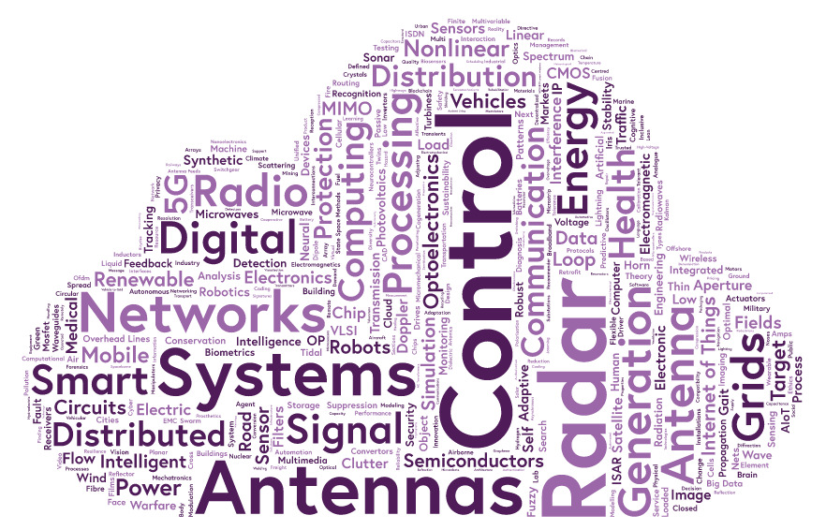
Books and eBooks
Our books reflect the role of engineering in solving societal challenges, proposing interdisciplinary solutions to complex problems, and exploring the scientific principles that underpin current and future technology. Our full collection of 750 books is available, along with a collection of this year’s books and a selection of themed collections.
Computing
Control, Robotics & Sensors
Electromagnetic Waves
Energy Engineering
Healthcare Technologies
Materials, Circuits & Devices
Radar, Sonar & Navigation
Security
Telecommunications
Transportation

Slide 5
Journals
IET Journals span all areas of engineering and technology – covering the disciplines of electrical, electronics, computing, control, biomedical and communications technologies. Our journal content is indexed in all major databases to help your users discover relevant content.
Current journals now fully Open Access
The latest content from over 40 journals is accessible through a publishing partnership with Wiley on the IET Research hub page.
IET Journals Archive 1872-2012
With over 145,000 full-text articles, the Journals Archive provides exclusive, unlimited online access to the IET’s extensive publishing history.

Slide 6
IET Inspec
Owing to the precision and accuracy of its indexing, IET Inspec is the authoritative resource for accessing scientific literature across engineering, physics and computer science. For over 50 years IET Inspec has been an essential discovery tool to numerous prestigious institutions around the world. Pinpoint relevant literature easily with precise, subject-specific indexing.
Content size
Content sources
Subject breakdown
21+ million records > 1969
1.1+ million new records added each year
14+ million peer-reviewed Journal articles
7.5+ million conference papers
240k+ preprints
3.8+ million Open Access items
500+ publishers worldwide
4,500+ journal titles actively indexed
650+ fully Open Access journals
70,000+ conferences
66,000+ book chapters
7,000+ videos

Slide 7
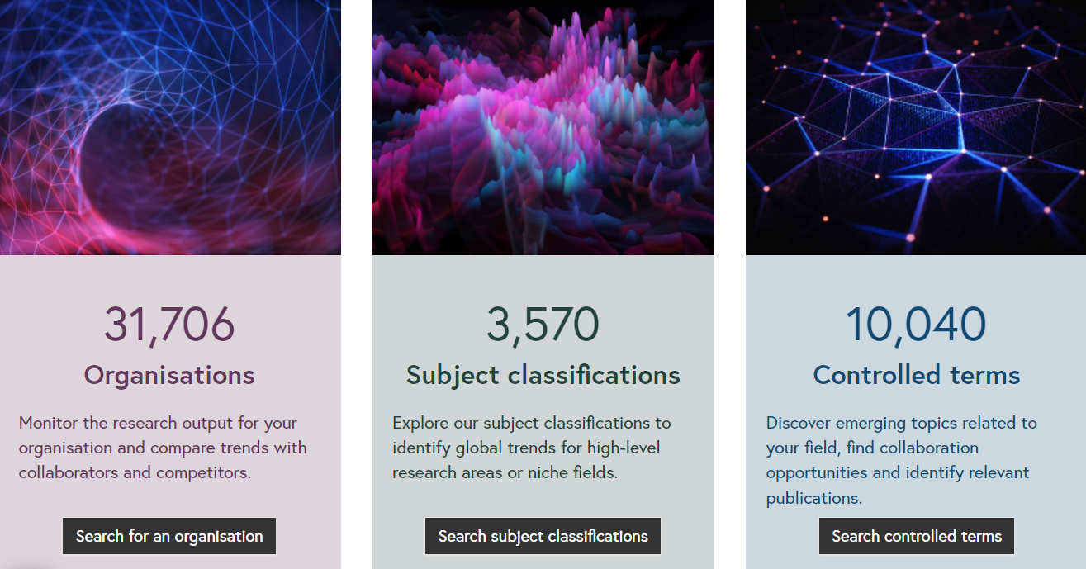
Inspec Analytics
Based on data from the IET’s renowned Inspec database, Inspec Analytics provides unique and actionable insights into the current research landscape to inform your strategic planning. Using powerful semantic mapping, this award-winning research intelligence tool uncovers previously hidden trends and patterns in global engineering and physics research.

Slide 8
Contact IET USA for additional information about our products
Christopher Suhrcke
Sales Manager, IET USA Inc
csuhrcke@inspecinc.com

