Slide 1
De gruyter And the University Press Library NORTH CAROLINA SERIALS CONFERENCE April 9, 2021 Presenter: Steve Sutton Regional Sales Manager steve.Sutton@Degruyter.com

Slide 2
About De Gruyter
A publisher of first-class scholarship for more than 270 years.
An international, independent publisher headquartered in Berlin.
Publish over 1,300 new book titles each year and more than 900 journals across the humanities and sciences.
Offer a wide range of databases
Host content from sixteen major publishers via the University Press Library Program

Slide 3
What is the De Gruyter University Press Library Program?
Complete Annual Output of eBooks From Major University Presses
Sold as Collections
All eBooks are DRM Free
Hosted on the Newly Launched De Gruyter Platform
Deeply Discounted
Metadata Support

Slide 4
What Makes the University Press Library Different From Other eBook Purchasing Models?
Expenditure Predictability
Complete Coverage
Best-In-Class User Experience
Highest Level of Financial Support For University Presses

Slide 5
Support for University Presses
Changes in technology, library budgets, and new forms of competing demands in the academic library marketplace have made the sustainability of scholarly publishing extremely challenging.

Slide 6
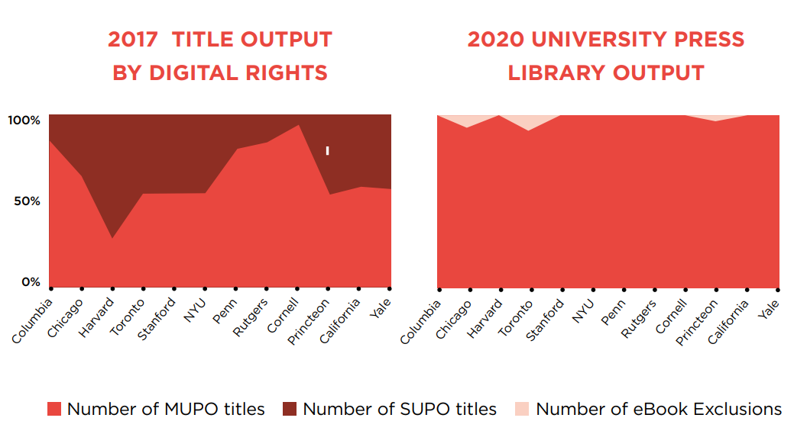
The University Press Library Meets The Need For Purchasing eBooks Free Of Digital Rights Management Restrictions
The red area represents the front-list availability with multi-user rights; the dark red represents the front-list availability in single-use only format in the 2017 graph.
Restrictive rights are lifted and replaced with multi-user rights with very few exceptions (pale red in the 2020 graph) via the University Press Library on the De Gruyter platform.

Slide 7
University Press Library Partners
0
DRM
Unlimited usage
58,000 titles in total
28 % Exclusive Content

Slide 8
Pricing and Discounts
Average number of titles per press predicted in 2021: 168
Average price before discounts: $130.88
Average price after discounts: $88.55
Additional special discounts will be offered when purchasing content from multiple university presses:
Number of Presses | Additional Discount from "Collection Price"
3 presses | 5%
6 presses | 7.5%
9 presses | 10%
12 presses | 15%

Slide 9
Discounts for smaller schools
Additional small school discounts will also apply, depending on Carnegie Classification:
Carnegie Classification | Additional Discount from "Collection Price"
Carnegie Large | 10%
Carnegie Medium | 15%
Carnegie Small | 25%
Carnegie Very Small | 40%
Community Colleges | 50%
Carnegie Special | 50%

Slide 10
Quality controlled CARE standards
CONTENT
Metadata upload on a weekly basis
Ongoing quality control of metadata and content PDFs
ACCESS
Collections created by copyright year derived from three seasons of publishing over a year and a half
Granting access to newly uploaded publications on a monthly basis
REPORTING
User-behavior reports from counter 5 compliance metrics to new data and analytics tools at the title and subject level
Title lists provided three months in advance of publication. Including all unlimited use and exclusion (print only) titles
eCOLLECTION MANAGEMENT
A DRM-free purchase model with no ongoing fees
Duplication control
Delivery of enhanced MARC records and KBART files. Collection targets in OCLC, Alma and INTOTA. Full text indexing in EDS, Summon and Primo

Slide 11
We are happy to answer your questions
Steve Sutton Regional Sales Manager steve.sutton@degruyter.com

