Slide 1
Opening our deep backfiles
Identifying open and public domain serial content in library collections
Presenters:
John Mark Ockerbloom
Rachelle R. Nelson

Slide 2
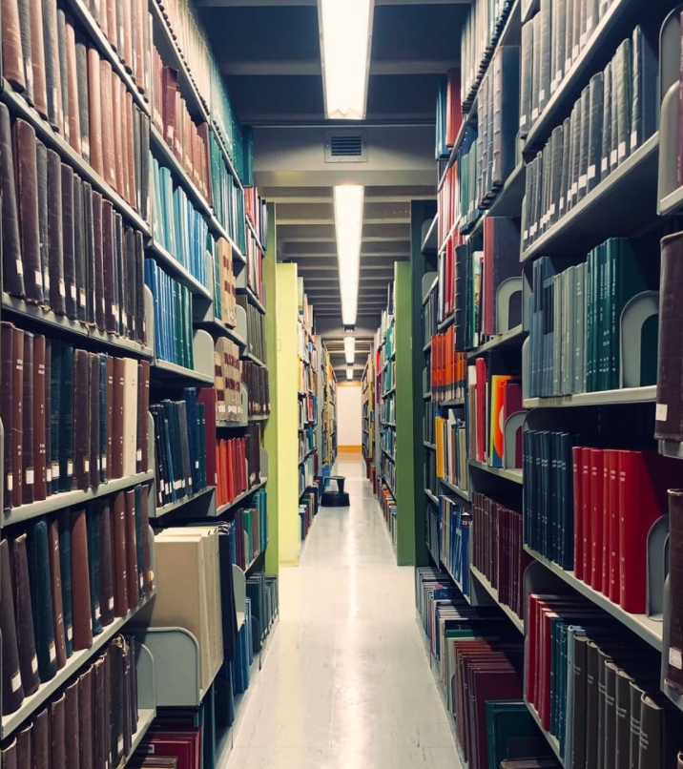
The problem
Lots of older serials with relevant research and cultural content, largely overlooked
and often hard to access, especially during a pandemic
Many of them (as late as 1960s or even 1980s) in the public domain, but their copyright status is unclear
Most did not renew copyrights; some didn't even claim them

Slide 3
What we're doing
•Identifying serials in the public domain, or with free online issues
•Publishing what we find as structured JSON data linked to Wikidata
•Linking to free online content and related material when we find it (including when it's under ©)
•Growing the public commons of serial literature
.
https://onlinebooks.library.upenn.edu/cce/db/

Slide 4
A variety of roles for a variety of workers
We trained 25 workers in 14 departments to search for copyright information in online databases and resources and complete web forms on their findings
Work can be done from home, with varying commitment levels

Slide 5
After the questionnaire, more specialized work
Verify staff answers
Create JSON records from the answers, generating web pages like this...

Slide 6
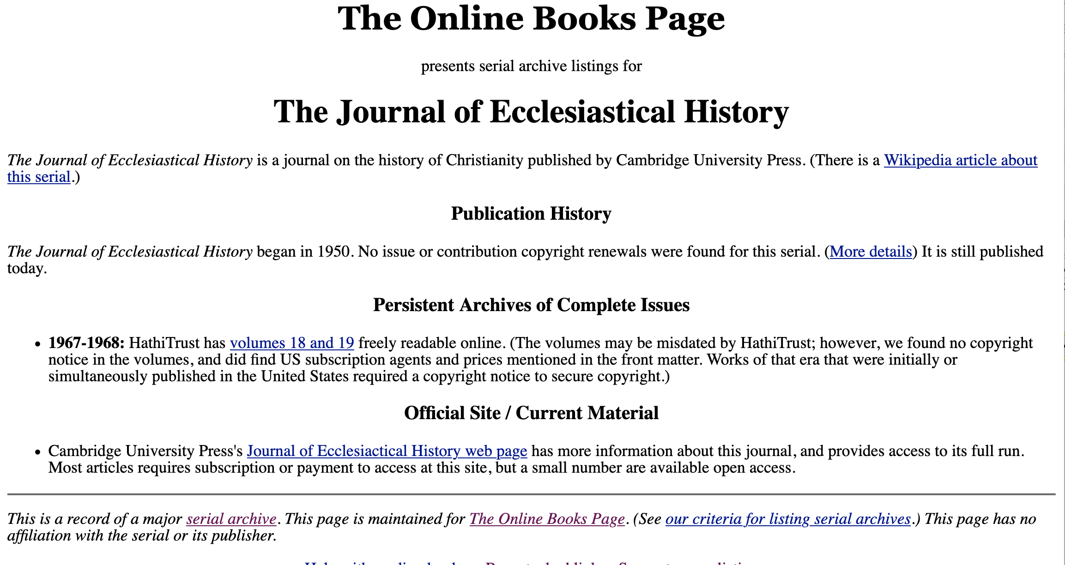
...and create records for free online issues if any...

Slide 7
...and link to Wikidata (creating items if needed)

Slide 8
Wikidata IDs & ISSNs pull all this data together
We also rely on a lot of careful work done, and data recorded, by serials catalogers in tracing and cataloging the serials that we document in this project

Slide 9
We can document more than just what Penn owns

Slide 10
How this work can benefit you
• You and your scholars can consult our knowledge base to find serial publications you can digitize, freely quote, or otherwise reuse.
• We're talking to some nonprofit mass-digitization projects about using our data to further open already digitized serial content

Slide 11
How you can build on this work
• You can work on the serials we’re working on as well
Researching copyrights, making wikidata records...
Or digitizing based on the data
• You can work on serials of special interest to you
Individually (whether or not they're part of one of our sets)
Or possibly define a set of your own to research (talk to us)

Slide 12
Where you can find out more
John Mark Ockerbloom
ockerblo@upenn.edu
Rachelle R. Nelson
nelsonrr@upenn.edu
Project page: https://onlinebooks.library.upenn.edu/cce/db/
Thank you!

