Slide 1
CORAL User Group Meeting at NC Serials
Xiaoyan Song, NC State University
Rebecca Tatterson, East Carolina University
Angela Dresselhaus, East Carolina University

Slide 2
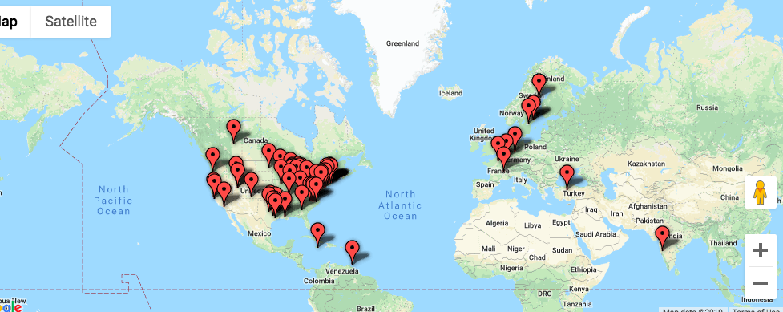
What is CORAL?
Open source ERM

Slide 3
Five Modules
Resources Licensing Organization Usage and Statistics Management

Slide 4
The Team
Steering Committee
Web Committee
Affiliates
Meet the team on the website:
http://coral-erm.org/meet-the-team/

Slide 5
Stay connected with CORAL
Follow us on social media
Subscribe to newsletter
Email: help@coral-erm.org
Subscribe to CORAL discussion list
Report bugs or enhancement on Github
https://github.com/coral-erm/coral/issues

Slide 6
What’s new?
Partnership with Open Library Foundation (OLF)
http://coral-erm.org/olf-and-coral/
3.0 release July 2018
3.0.1 patch release Feb. 2019

Slide 7
More languages in 3.0
New in 3.0
German
Turkish
Other languages
English
French
Chinese simplified
Chinese traditional

Slide 8
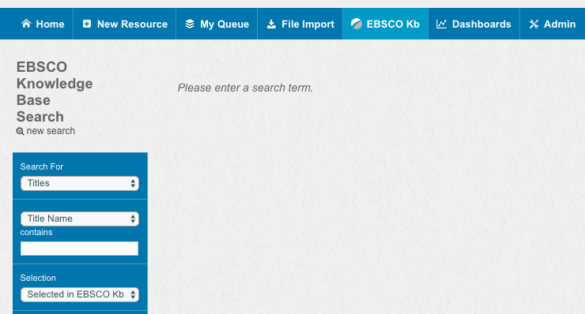
EBSCO KB Integration with Resources in 3.0

Slide 9
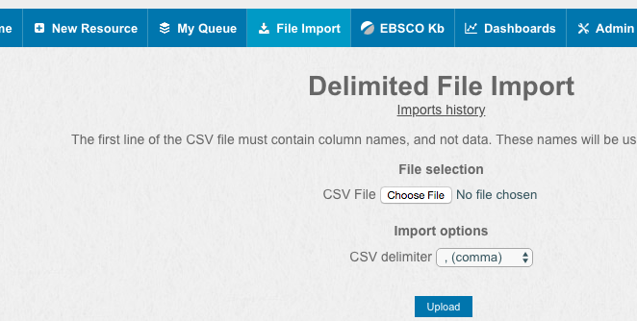
Import Tool Enhancements in 3.0

Slide 10
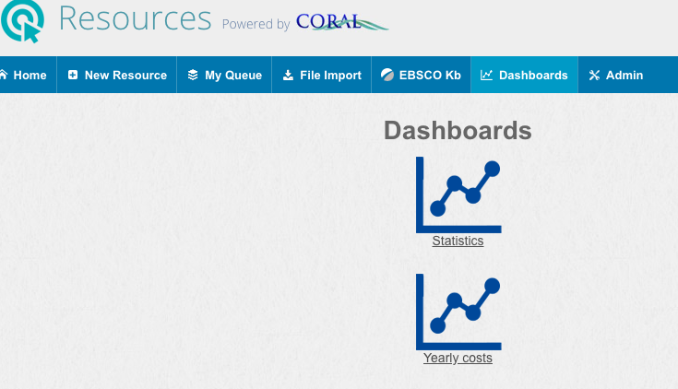
Dashboards in 3.0

Slide 11
Other Enhancements in 3.0
CORAL/ILS Koha Interaction
Add multiple orders in Resource module
Duplicate an existing workflow in Admin
Additional search fields including Publisher, Platform and Provider
For details, check out the 3.0 documentation online
http://docs.coral-erm.org/en/latest/

Slide 12
NC State University Libraries’ Use of CORAL
Six years now
Manage workflows for Monographs firm orders and new database orders
Contribute to functionality enhancements
Workflow / import tool / API order request form
For more information, check out these two presentations
NC Serials 2018: Streamlining Acquisition Workflows Through Collaboration And Innovation
NC Serials 2016: Pulling it all Together - Using CORAL ERM for Serials Acquisitions Management

