Slide 1
ORCID Popups: Starting Small to Disseminate at Large
Lynnee Argabright
University of North Carolina at Chapel Hill
lynnee@live.unc.edu

Slide 2
ORCID Team at UNC- Chapel Hill
Librarians across campus at the University Libraries (e.g., Health Sciences, Kenan Science, Davis Libraries)
Webinar (Sept 2018) reporting of outreach preparation: https://youtu.be/Gb0clgH91sM
Contact
orcidteam@unc.edu
https://guides.lib.unc.edu/orcid

Slide 3
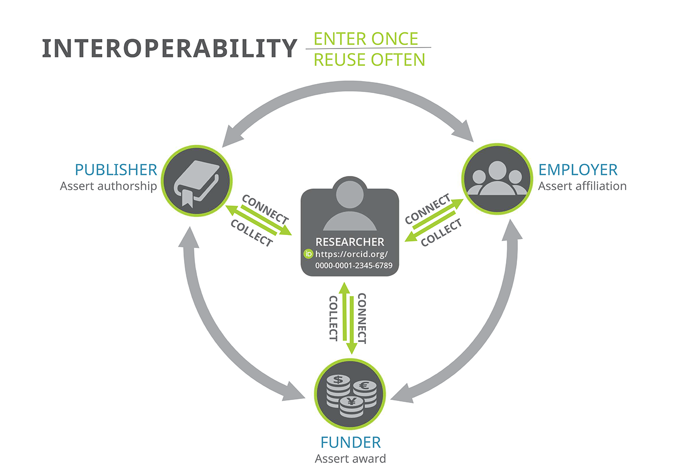
What is ORCID and Why Do We Need It?
Notes:
-Identifier for researchers
-Registry connecting information for grant applications
-Profile linking all research done across dissemination formats throughout researcher’s career
-Organizations automated input and verification of scholarly activity
-Institutional access provides consolidated awareness of all researcher activity throughout the university

Slide 4
ORCID Implementation
Preparation
IT Connection
Train the Trainers
Outreach
Administrative Support
Notes:
-Outreach preparation: create stock slideshow for various training purposes, create libguides
-IT connection: set up ORCID portal so easier use
-Train the trainers: trained librarians to help spread outreach and training
-Outreach: Targeted presentations, newsletter ads, popups
-Administrative analysis support?: Broaden audience and incentives

Slide 5
Popups: One Outreach Solution
Reach out to interested, likely departments
Schedule during department-wide meetings
After a departmental ORCID presentation/introduction
Convenient sign-up staff, instructions, and laptops
Follow up with department after popup event

Slide 6
Challenges
Was slow during, but crazy while everyone was leaving.
Better response as people arrived (if they weren't late).
Didn’t bring phones for authentication.
Faculty didn’t want to be there, not willing to listen.
Faculty exited out of alternate doors or were in deep conversation upon exiting.
Lessons
Have one person stay after meeting.
Focus on departments with incentive.
Value in the introductory question.
Combine outreach for departments to increase visibility.
Subject librarian involvement makes a difference.

Slide 7
Sample Data
Total 251 total UNC fac/staff linked (105 faculty linked) | 5059 total UNC faculty = 5% (2.1%)

Slide 8
Sample Data
Total 251 linked 5059 total faculty = 5%

Slide 9
Future Goals
Increase communication of Create AND Connect
Get administrators to create and connect ORCID
Have data and answers for why faculty should be motivated
Get more subject librarians involved to spread outreach.
Produce data showing value in institutional membership.

Slide 10
Questions?
Lynnee Argabright
MSIS candidate at UNC-Chapel Hill
Open Access Research Assistant at UNC-Chapel Hill Libraries
lynnee@live.unc.edu
linkedin.com/in/lynnee-argabright/
@LynneeLue
orcid.org/0000-0001-6814-6485

