Slide 1
Old Serials, Dirty Data: Print Retention as an Opportunity
By Beverly Dowdy and Mandy Hurt
NC Serials Conference
April 6, 2018

Slide 2
What is Print Retention?
Each library commits to keep assigned serial titles, and some or all of its holdings, as part of a consortial agreement.
Usually for 25 years, with the possibility of renewal

Slide 3
What is Print Retention?
Reflects a different way of thinking:
Above the institution
Networked
Collections as a service
The desired result is a complete print collection, but not all in one place. Titles and holdings reside at different institutions.

Slide 4
Why commit?
The pressure is on: for space.
Allows participating libraries options for wise use of their space
Stacks, compact shelving and remote storage
How we have coped in the past in dealing with space demands.
Libraries continue to buy print.

Slide 5
The risks of not committing
How do academic libraries keep from deaccessioning the same titles and volumes?
Especially the space-eaters when the library has a subscription to it online?
Examples: Nature, Time

Slide 6
The advantages of committing
Ensures a wide bibliographic diversity between multiple libraries within a geographic area.
No one can afford to keep everything.
No fee interlibrary loans written into the agreements.

Slide 7
The serials print retention network
Consortia which sponsor agreements for serials:
ASERL Scholar’s Trust (TRLN)
Center for Research Libraries
Rosemont Shared Print Alliance
Other consortia sponsor agreements for monographs

Slide 8
Scholar’s Trust
Consortia of 29 libraries
Provides retention commitments through 2035
Synchronized archiving policies
No fee, priority service for ILL requests from participants
As part of Scholar’s Trust, the TRLN Collaborative Print Retention Program has committed a total of 147,765 titles so far

Slide 9
TRLN Collaborative PR Program
TRLN maintains a publicly accessible list of titles retained here:
http://www.trln.org/programmatic-councils/collections-council/collaborative-print-retention-committee/

Slide 10
Center for Research Libraries
PAPR database for serials (Print Archives and Preservation Registry)
A directory of all print archiving programs with their titles and holdings
Keeping track of all the data: http://papr.crl.edu/

Slide 11
Center for Research Libraries
Cooperation and Data
“Given the magnitude of the print serials corpus, CRL must align its own shared collections effort with those of other U.S and Canadian libraries committed to preserving print.”
“’Libraries of record’ will play an essential role, we are part of the existing safety net.”

Slide 12
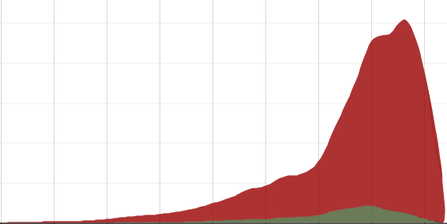
Center for Research Libraries
“Unfortunately, confidence in the accuracy and currency of existing bibliographic and holdings records for print serials is low. Records currently available locally and in WorldCat are ‘not up to the task.’”
“Many do not indicate gaps or lack unique identifiers, for example.”
“The cost of good holdings and bibliographic data is high and our holdings records aren't ready.”

Slide 13
Congratulations! You’re the Library of Record!
…Now what?

Slide 14
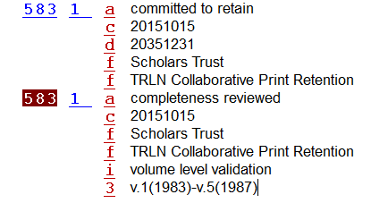
In an ideal world
Add retention statements to the relevant holdings records

Slide 15
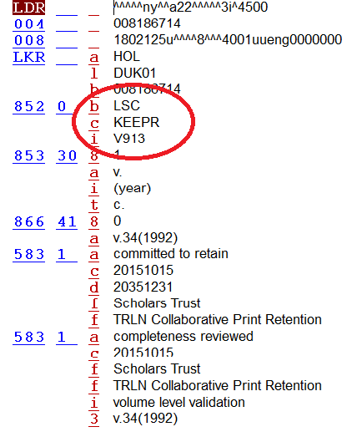
Create a new holding location code to safeguard against accidental deaccessioning

Slide 16
Image from Pixabay.com

Slide 17
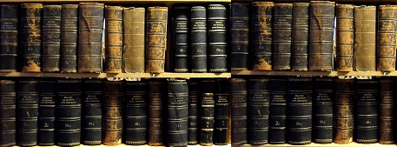
In the real world
Serials are complicated and convoluted
Titles change, merge and split
Record updates spanning decades
Different software
Different cataloging rules
Different local policies
Image from Pixabay.com

Slide 18
Dirty data ~ all libraries have it (yes, we’re including you)
Historically
Service points and practices
Specialized staffing
Currently
Demand for user space
Decreased staffing levels

Slide 19
The We’ll Fix It Later principle
Mission Impossible… or accessioning by any means necessary
The Fix On Failure principle
… Please ignore the laundry that fell behind the washer

Slide 20
Organizations such as the Center for Research Libraries require accurate records and holdings ~ We’ll fix it now!
Print Retention as Opportunity

Slide 21
Bibliographic Records
(Re-)Cataloged to CONSER standards
RDA standards
NACO work
Tracing of preceding and succeeding titles
ISSN Center

Slide 22
Dump records

Slide 23
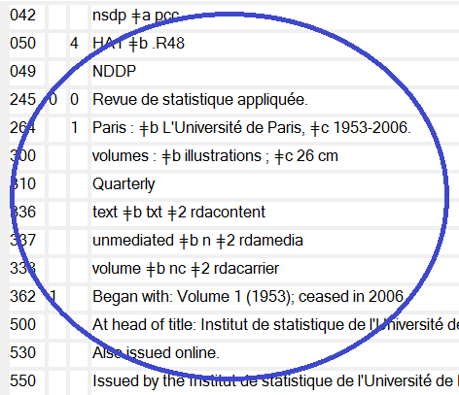
Updated record

Slide 24
Holdings records
New retention holding created if necessary (retention notes added)
Summary holdings reviewed and updated to meet ANSI NISO Z39_71 standards
Legacy notes – interpreted, transcribed and/or deleted
Matches chronology of bibliographic record?

Slide 25
Title changes, splits and merges
1934-1984
1934-1940
1941-1947
1948-1952
1953-1965
1966-1974
1975-1984

Slide 26
Item Records
Date range match to bibliographic and holdings record
Accurate description to current standard
Items reviewed for completeness
Scholars Trust has whole volume validation
Attempt to validate “phantom” un-barcoded items

Slide 27
I have the world's largest collection of seashells. I keep it on all the beaches of the world... perhaps you've seen it. ~ Steven Wright
Cooperative Cataloging for a Collaborative Collection
Image from Pixabay.com

Slide 28
Beverly.Dowdy@duke.edu Mandy.Hurt@duke.edu
Questions?

