Slide 1
No Satisfaction? But We Try and We Try and We Try! Presented by Tonia Graves, Old Dominion University libraries 26th Annual North Carolina Serials Conference March 31, 2017 Being Data-Informed: Taking Control and Connecting Users to Content
What do Old Dominion University Libraries’ users and the Rolling Stones have in common? Both have expressed a need for more satisfaction.
This presentation will explain how we are using data from our LibQUAL+ survey results to improve our user’s experience and level of satisfaction.
Notes:
Thank you for the introduction. And Thank you to the conference organizers, sponsors, and volunteers. I’m happy and honored to be here today and share with you this presentation called No Satisfaction? But We Try and we try and we try!
When Old Dominion University Libraries conducted the LibQUAL+ survey in 2015, results indicated a lack of satisfaction among some participants in discovering and using our electronic resources. This presentation will describe two enhancements, implemented in the last 6 months, that we hope will positively impact our user’s experience and raise their level of satisfaction.
**************************************************************************************************************************
Old Dominion University Libraries conducted our first LibQual Survey in fall 2015 and the results data indicated that our users were not satisfied in the category of the survey called “Information Control”.
Today I will describe two examples of how we’re trying to improve user experience and increase their levels of satisfaction with information control. One example will be enhancements we’ve made to our ez proxy error page that allows users to report the problem and gives them altervatives for help instead of leaving them with a screen of technical jargon with no clear indication of what to do next. The other example will be how we’ve enhanced our Journals A-Z page by providing an option to search by subject using a third party with our new discovery layer.
help users connect more effectively with our information resources, resulting in an improved user experience and an increased level of satisfaction

Slide 2
What is LibQUAL+ ?
A survey that’s been used by over 1200 libraries worldwide
Assesses three dimensions:
Library as Place
Affect of Service
Information Control
Three measures to rank satisfaction with service quality:
Minimum
Desired
Perceived
Notes:
Let me begin by providing a little context about the LibQual+ Survey.
By a show of hands,
Is anybody familiar with the LibQual survey?
Has anybody’s institution conducted the LibQual survey?
Has anybody’s institution acted upon the results of the LibQual survey?
LibQual was launched in 2000 as an experimental project for benchmarking perceptions of satisfaction with library service quality. The survey measures satisfaction in three categories, Library as Place, Affect of Service, and Information Control. Information Control is the category we’re focused on and I’ll explain in the next slide or two why that is. The survey uses three measures to rank satisfaction: minimum, desired, and perceived.

Slide 3
Responses
2203 views
Incomplete – 1293
Complete – 910
Valid – 827
By population:
Undergraduate – 508
Graduate – 179
Faculty – 93
Staff – 47
Notes:
Our survey ran for three weeks, and we ended up with a 37.5% valid response rate.
When combined, the faculty and graduate students represented 272 survey participants or a third of the total AND they were the populations who indicated that they were the least satisfied in the information control category..
*********************************************************************************************************************************************************************************
Our survey was launched in September 2015. It ran for three weeks, which is the amount of time recommend by ARL, and was closed in October. We ended up with a 37.5% valid response rate.
The majority of our respondents (n=508) 61% were undergraduates, skewing slightly in favor of third-year students. 22% of the responses were from graduate students (n=179), and faculty represented 11% of responses. (n=93)
The LibQual+ survey was viewed a total of 2203 times. Of those views we received 910 complete surveys, and 827 valid surveys. 37.5% valid response rate.

Slide 4
INFORMATION CONTROL QUESTIONS
1: Making Electronic resources accessible from my home or office
2: A library Web site enabling me to locate information on my own
3: The printed library materials I need for my work
4: The electronic information resources I need
5: Modern equipment that lets me easily access needed information
6: Easy-to-use access tools that allow me to find things on my own
7: Making information easily accessible for independent use
8: Print and/or electronic journal collections I require for my work
Notes:
SO WHY INFORMATION CONTROL YOU ASK?
LibQual+ consists of 22 questions which are grouped into three categories: Service, Library as Place, and Information Control. If you compare these 8 questions in the information control category with the questions in the other two categories, I think you will agree that Information Control is the that most closely aligns with the work that we do.
It was also the category with the overall lowest levels of satisfaction and the area where my unit and I could make the most impact.
********************************************************************************************************************************************************************************************
Being that this is a conference based on serials and electronic resource management issues, we thought this was a good connection.
Most egregious of the reasons cited by faculty and graduate students for their lack of satisfaction in this category included:
failing to provide a library website that enables them to independently locate information and,
absence of the journals they need.
NEED TO MAKE THE CONNECTION THE INFORMATION CONTROL CATEGORY IS THE MOST RELEVANT OF THE THREE TO OUR WORK IN THE LIBRARY WITH SERIALS AND ELECTRONIC RESOURCES. I THINK THIS HELPS MAKE THAT CONNECTION.

Slide 5
SINCE the 2015 libqual+ survey…
Migrated to New ILS/Discovery Service – July 1, 2016
Online User Experience Librarian – November 2016
Enhancements to EZ Proxy Error Page – November 2016
Enhancements to Journals A-Z Page – February 2017
Notes:
Since we conducted LibQual+ here are several actions taken:
Migrated to new ILS / Discovery Service in July 1, 2016 (Almost a year now.)
Hired a User Experience Librarian in November 2016.
The first two efforts were taken at a library wide/administrative level.
The second two efforts grew mainly out of my work experiences and they are two I will focus on today: Enhancements to our EZ Proxy Error Page and Enhancements to our Journals A-Z page.
*************************************************************************************************************************************
Today I will focus on the last two examples from this list that illustrate how we’re trying to improve user experience and increase their levels of satisfaction. One example will be enhancements we’ve made to our ez proxy error page that give users options for help instead of leaving them with a screen of technical jargon with no clear indication of what to do next. The other example will be how we’ve enhanced our Journals A-Z page by providing an option to search by subject using BrowZine as a third party to our new ExLibris Primo Discovery layer.

Slide 6
Notes:
So, the first enhancement, improving the EZ Proxy Error page – started after I attend a workshop at a conference in early 2016 and realized how much better we could be serving our patrons if we could incorporate some of the methods suggested in that workshop. We implemented methods used by Austin College and as you will see in the next few slides, a little scripting, google forms, and an e-mail account have gone a long way for us in providing user help and decreasing problem resolution time.
This is our former EZ Proxy Error page, or the page that patrons see when they can not access their desired resource because the “host” is not accounted for in our configuration file.
The page is pretty sparse,
does not have our standard header or footer
There are no links for help.
The language is very technical.
And the e-mail address, which is blocked for this presentation, was not hotlinked.
So basically we presented users with a page of techno talk and no options or links for assistance.

Slide 7
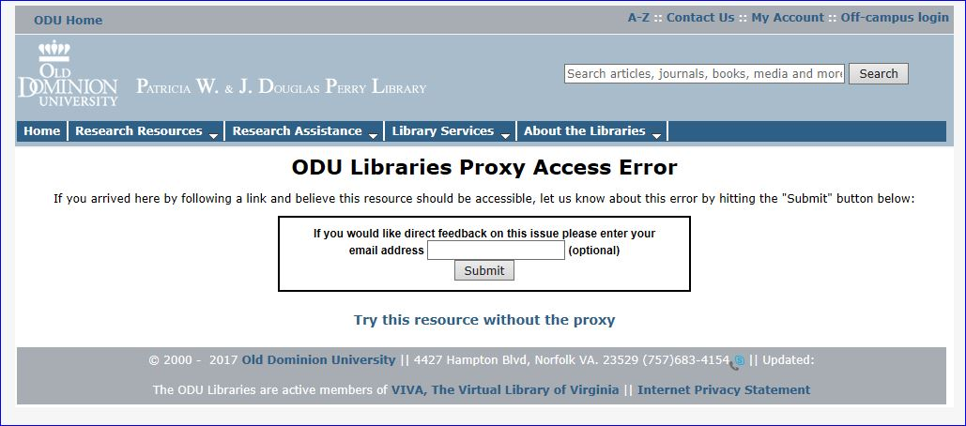
Notes:
This slide shows our enhanced ez proxy error page, that debuted Nov 4, 2-16. (almost 5 months now)
Now our standard library header and footer are present and they contain links for assistance that were not available in the previous version.
The wording is less technical and more human friendly.
Patrons can report the error simply by clicking on the submit button. That’s all they have to do.
They can include their e-mail address if they choose to.
We also include an option for the patron to try this resource without the proxy which can be helpful in many cases.
After the submit button is clicked on, the submissions are delivered to an e-mail account and a Google spreadsheet which are both shared among our Systems Specialist for Internet Technologies, our electronic resources assistant, and myself. Our Electronic Resources assistant trouble shoots the submissions, indicates on the spreadsheet when the problem is resolved, and follows up with the patron if they provided their e-mail.
*******************************************************************************************
To take a peek at it just use a URL like this: https://login.proxy.lib.odu.edu/login?url=http://thisisanimaginary.url
Now keep in mind, this is one of those potentially sensitive areas where you don’t want to draw a lot of attention to the fact that there are problems in the discovery system, but let’s face it, there are problems in the discovery system! So if we can get patrons to easily self-report and provide alternatives, that’s what we’re in favor of doing.

Slide 8
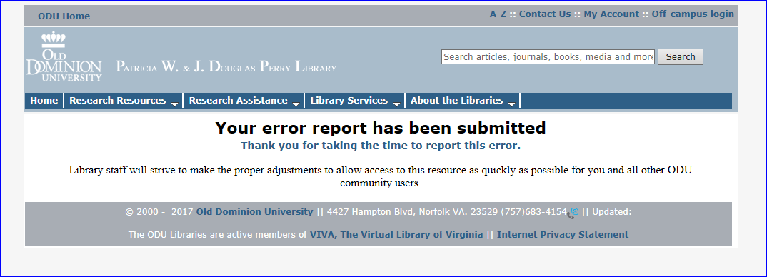
Notes:
This slide shows the screen patrons see after clicking on “submit”. It has a more friendly and human tone to the message and thanks the patron for their time.
Has this enhancement created more work for us you ask? You bet.
We went live with this on 11/04/16 and we had our first submission on 11/05/16.
From 11/05/16-03/05/17 (a 4 month period) we’ve had:
75 submissions
40 submitters gave their e-mail; 35 did not.
*************************************************************************
One interesting story-right at the start of this semester, from 01/04/17-02/28/17, we received 16 reports on the same link. We were able to use the referring url to trace the url to an outdated syllabus that had been given to students in a class this semester. We contacted the professor and all the students who left their e-mail.
Other positive stories we see emerging from this include:
Helping Identify system-wide outages. If we’re receiving reports on the same thing, we can see problem and start troubleshooting.
The Referring URLS that are contained in the Google Spreadsheet are a helpful analytic. We can see what resources our users are coming from when trying to access our resources and the time of day they are trying to connect without needing access to the EZ proxy logs.
Increasing staff understanding and participation in ERMS - specifically ez proxy management.
One thing to be aware or One interesting thing we can see from those who did leave their e-mail -1 person reported the same error 3 times all within two minutes. And two others reported their same error twice within two minutes. This raises some questions about whether or not the understands what’s going on, perhaps they are eager clickers, or stubborn, or expected to see a resolution right away. In most instances the error is only submitted once, but these few anomalies of multiple submissions may warrant looking into.
Another interesting story is the day our Systems Staff was doing server maintenance which led to one highly used database going down, and boy did our submission form and e-mail account started to pop. There was nothing posted at the vendor sight about an outage, there were no uproars on any listservs, etc., and our metadata was good. After consulting with our Systems department, we determined that the server maintenance was the cause and were able to restore access.

Slide 9
Enhancements to Journals Finder– February 2017
Notes:
Our 2nd enhancement, resulted as a combination of responding to our LibQual+ survey result data AND because we took a beating after we went live with our new discovery system because the Journals A-Z page no longer had an option to search for Journals by subject. Our users were very unsatisfied with the new page and very vocal about it.
This slide is our journals A-Z page that debuted with our new discovery system on July 1, 2016.
It’s a bit sparse, with just an alpha/numeric browse option and a simple search box. The search box has just one search option-Find Journal by Title. There were no options for search by ISSN, call number, title begins with, or subject as our patrons were used to. The new journals A-Z page generated such immediate negative response, particularly from faculty and grad students, that we knew it had to be prioritized for improvement.
****************************************************************************************************************************************************************
The page went from having multiple search options and help features to just two search options and little help features. The lack of an option to search for journals by subject was deemed unacceptable by our faculty and they were vocal.
Talk about when we did this, super recent, and any way we’ll track perceived increased satisfaction, etc. Will we have any meaningful BrowZine usage or analytics yet? Mention what we’ve done since the March meeting and the upcoming April meeting. Should I mention the steps in took in Alma if I have time? Or save this for an aside?

Slide 10
Enhancements to Journals Finder– February 2017
Notes:
This slide shows the page that debuted in February 2017.
Now when you click on the Journal Finder tab, from the home page, you land on this splash page with an array of options. The first link is still to search for Journals A-Z and goes to the page powered by our discovery system, seen on the previous slide. The second link is to search for Journals by subject. This is how we’re responding to our patron’s demand for an option to search for journals by subject.
The page is powered by BrowZine, which is a third party service that allows you to browse, read and follow scholarly journals. We already subscribe to the service, so we’re using it now to respond to patron outcry about the lack of subject search.
*****************************************************************************************************************************************
The Journals A-Z still goes to the page powered by our discovery system.
The Journals by subject link is powered by BrowZine.
The splash page also contains other traditional help features such as citation help, ask a libr, and chat.

Slide 11
Enhancements to Journals Finder– February 2017
Notes:
This is where you land when you click on the Journals by Subject link. You can search or browse by subject from a less sparse, more visually pleasing page.
Is this enhancement additional work for us you ask?
You bet.
We have to ftp a load of records from our ILS to BrowZine monthly, although APIs are in development that will automate this process.
There’s a lag time of one month for edits in our ILS to appear in BrowZine, although BrowZine says if we have an unusually large amount of changes, to contact them and they will expedite the load.
Not all journals are in BrowZine. There are no print journals in BrowZine. We crafted a disclaimer statement to address this that reads “(Note: this list is not comprehensive. Notice a title missing? Let us know!)” and the Let us know! link goes to our Ask a Librarian Form.
*****************************************************************************************************************
I think we need to develop a form more specifically for this purpose instead of the generic Ask A Librarian form and will include that suggestion when we assess this service. We also need to be more knowledgeable about BrowZine’s taxonomy.

Slide 12
WHY WERE THESE ENHANCEMENTS successfully IMPLEMENTED?
Align with library priorities
Good relationships and buy-in from colleagues
Relatively low cost for equipment / Most costs are human resources
Manageable workflows post implementation
No support outside of library required
Good 3rd party vendor support and documentation
Notes:
Here are a few reasons why I think we were able to move ahead with our two enhancements: It always helps if what you want to do aligns with library priorities. And number 2, couldn’t have done it without support from our Systems staff and our user experience librarian. Also, relatively little additional cost, and requiring no support from outside of the library is good.
And, Have we improved user Satisfaction?
These enhancements are new and hard to measure so it’s hard to know right now what impact they are having.
We know that both enhancements are being used, so we perceive that as positive.
If we do the LibQual Survey again, we can compare results to see if satisfaction has increased.
In the meantime we’ll continue to try.
********************************************************************************************************************
What made these two efforts successful to implement?
Good timing in terms of the changes aligning with library priorities
Good relationships and buy-in from my colleagues
Relatively little cost
Manageable workflows post implementation
No support outside of library required
Good 3rd party vendor support and documentation

Slide 13
Have we improved user satisfaction?
Both enhancements are being used=good sign.
Repeat LibQUAL+ to compare results.
Notes:
And, Have we improved user Satisfaction?
It’s to soon to tell.
These enhancements are new and challenging to measure so it’s hard assess right now what impact they are having.
We know that both enhancements are being used, so we perceive that as positive.
If we do the LibQual Survey again, we can compare results to see if satisfaction has increased.
In the meantime we’ll continue to try.
********************************************************************************************************************
What made these two efforts successful to implement?
Good timing in terms of the changes aligning with library priorities
Good relationships and buy-in from my colleagues
Relatively little cost
Manageable workflows post implementation
No support outside of library required
Good 3rd party vendor support and documentation

Slide 14
SOURCES
The Rolling Stones. "(I Can’t Get No) Satisfaction." Out of Our Heads, London Records, 1965.
Old Dominion University Libraries LibQual+ Task Force. (2016) The Library Quality Survey Results Report [PowerPoint slides].
Bunton, G. & Fox-Teichmann. (2016) EZProxy: Assessment & Administration Tips and Tricks [PowerPoint slides]. Retrieved from https://www.dropbox.com/sh/euz6nik1risrqfz/AAC5owRm6nf2 kT-NycT8qXHMa?dl=0&preview=W03-Workshop+-+EZProxy+- +Assessment+and+Administration+Techniques+and+Tips.pptx
Notes:
Here’s a slide to show my sources and gratitude.
********************************************************************
Online Lecture Notes and Presentation Slides
When citing online lecture notes, be sure to provide the file format in brackets after the lecture title (e.g. PowerPoint slides, Word document).
Hallam, A. Duality in consumer theory [PDF document]. Retrieved from Lecture Notes Online Web site: http://www.econ.iastate.edu/classes/econ501/Hallam/ index.html
Roberts, K. F. (1998). Federal regulations of chemicals in the environment [PowerPoint slides]. Retrieved from http://siri.uvm.edu/ppt/40hrenv/index.html
Bunton, G. & Fox-Teichmann. (2016) EZProxy: Assessment & Administration Tips and Tricks [PowerPoint slides]. Retrieved from https://www.dropbox.com/sh/euz6nik1risrqfz/AAC5owRm6nf2kT-NycT8qXHMa?dl=0&preview=W03-Workshop+-+EZProxy+-+Assessment+and+Administration+Techniques+and+Tips.pptx
Old Dominion University Libraries LibQual+ Task Force. (2016) The Library Quality Survey Results Report [PowerPoint slides].

Slide 15
Thank you!
Tonia Graves
Electronic Resources and Serials Services Librarian
Old Dominion University Libraries
757-683-4188
tgraves@odu.edu
Notes:
And here’s my final slide with my contact info.
Thank you.

