Slide 1
“Don’t Panic: It’s Just a Backlog of Government Document Serials Records”
Elisabeth Garner, M.L.S., Library Specialist
Randall Library, University of North Carolina Wilmington

Slide 2
Fine-tuning a system for working with Government Document Serials records….

Slide 3
1. Receive our monthly Gov Doc records: we are a part of the MARCIVE (CRDP)

Slide 4
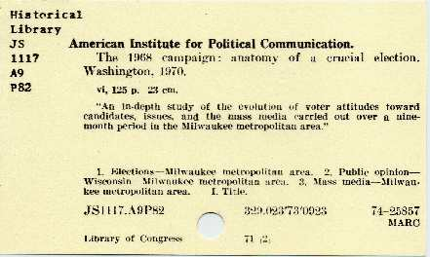
2. 1. Supervisor creates spreadsheets 2. Print “New Serials” and “Overlaid Serials” spreadsheets 3. Pull cards from the Shelf-List
Notes:
1. Supervisor creates spreadsheets from the files that are sent to her through MARCIVE. 3. Either I, or student workers, will pull cards from the shelflist

Slide 5
An example of one of the Serials lists I work with

Slide 6
Out in the stacks, with a laptop…what a view!!
Notes:
Explain what audience is looking at, Military Review, various months and issues, confirming what we have on the shelf, matches what we have in the catalog.

Slide 7
Open our catalog (Sierra), and pull up the record.
Possibility of more than one SuDoc call number
Check shelves for all possible SuDoc call numbers
Notes:
I open our ILS (Sierra) and then key in the OCLC# to view the first record.
One Serials record may have up to six different SuDoc call numbers. This one has three. I check each of these locations in the stacks, make changes as necessary to the records in our catalog.

Slide 8
We’ve found plenty of incorrectly cataloged records
Print item cataloged on an online record, etc.
Correct this while out in the stacks/or back in the office
Notes:
For example, someone previously cataloged a print item on the electronic version of that Serials record. I’ll make note of this on my sheet, and then correct this when I return to my office; or I may do this while out in the stacks, depends on how big of an issue it might be!

Slide 9
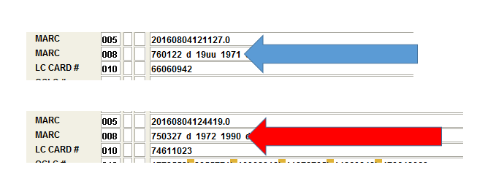
Serials records list a year-span in the 008 field-watch this!
Re-catalog mistakes made by others….
Notes:
Also, Serials records generally list a year span of which items should be cataloged on that particular record, in the 008 field. I have found several instances where I have had to re-catalog certain items “onto” their correct Serials record, with the correct date range, for example….

Slide 10
Repeat these steps for each item on the list! Last but not least….. TRY TO HAVE FUN WITH IT!
Notes:
I then repeat this for each item record I have on my Serials’ list for that month. Some lists are shorter or longer than others; it just depends from month to month, how many records MARCIVE sends us, based on our depository profile.

Slide 11
Follow the same process for the “Overlaid Serials” file
Takes less time, but necessary.
Unaware from month to month, which records will be Overlaid.

Slide 12
And lastly….. I hope I’ve offered at least one idea that can help you organize your Serials records!

Slide 13
Elisabeth Garner, M.L.S., Government Information Specialist, Randall Library @ UNC-Wilmington
*All images, except UNCW Library photo, taken from Google search, “Librarian memes.”
2-17-2017

